Slide 1
COB: MSBA 653 TruSource Report
Olivia Ngueguim, Samuel Ibikunle and Ugo Achara

Slide 2
Table of contents
01
04
02
05
03
06
Case Background
Modeling
Data Overview
Segmentation
EDA
Recommendation

Slide 3




Case Background​
Business lies in meeting customer needs, reflected through satisfaction, retention, and expansion. This analysis uses TruSource’s customer data to identify churn related behavior and develop a predictive model that supports longterm profitability and attention across customer segments.
Business problem: Why churns matters
Keeping existing customers is cheaper than finding new ones
High churn hurts revenue stability
Reducing churn increases the customer lifetime value and longterm growth
Early detection allows targeted retention efforts

Slide 4
Data Overview
Dataset includes 5636 customers with 36 features covering services, demographics and billing history, with some missing values represented below.
Total billed
Internet tech
Recent offer
0.14%
21.5%
55.1%
Used average total billed to preserve financial accuracy
Missing values labelled as unknown tech
Missing values treated as no offer received

Slide 5
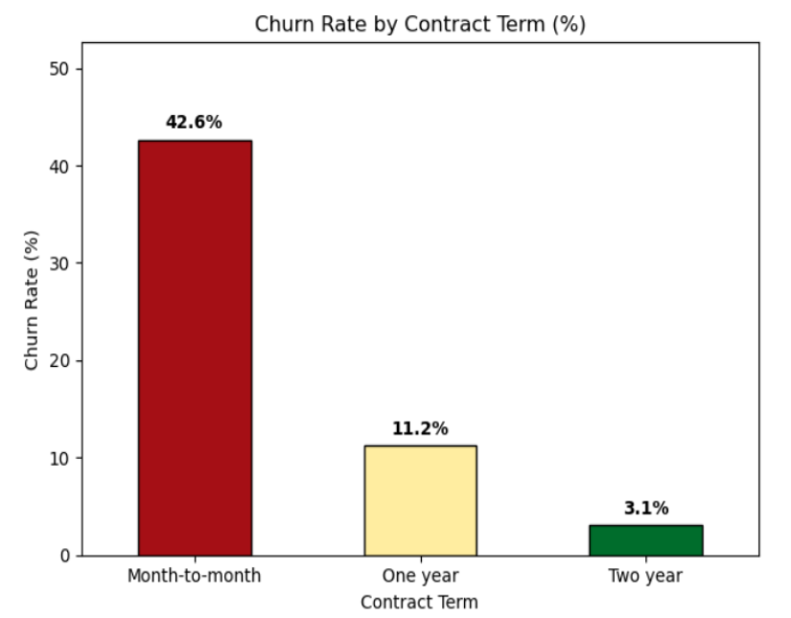
Exploratory Data Analysis(1/4)

Slide 6
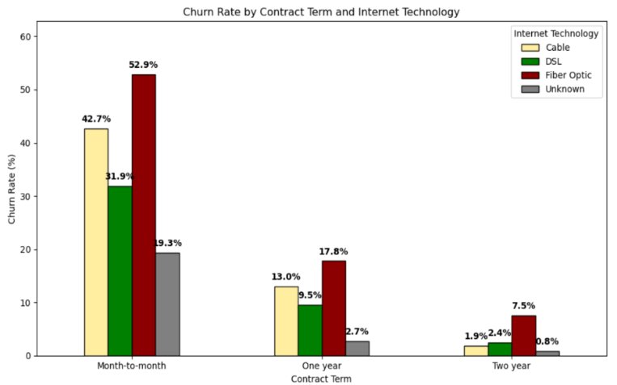
Exploratory Data Analysis(2/4)

Slide 7
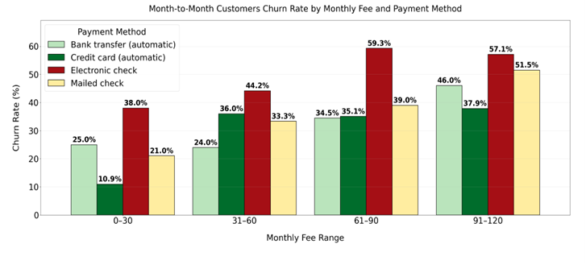
Exploratory Data Analysis(3/4)

Slide 8
Exploratory Data Analysis(4/4)
Customer churn rate by service categories
Service Categories | Service Type | Churn Rate (%)
Add-Ons | Security | 29.8%
 | Protection | 43.1%
 | Backup | 38.1%
Streaming | Stream TV | 50.8%
 | Stream Movies | 50.1%
 | Stream Music | 50.3%

Slide 9
Feature Engineering
Add-Ons services
Recent offer
Add-ons will be combined to create a binary variable. Representing the overall customer engagement.
Recent_offer will be converted to a binary variable. Indicating whether a customer received an offer or not.

Slide 10
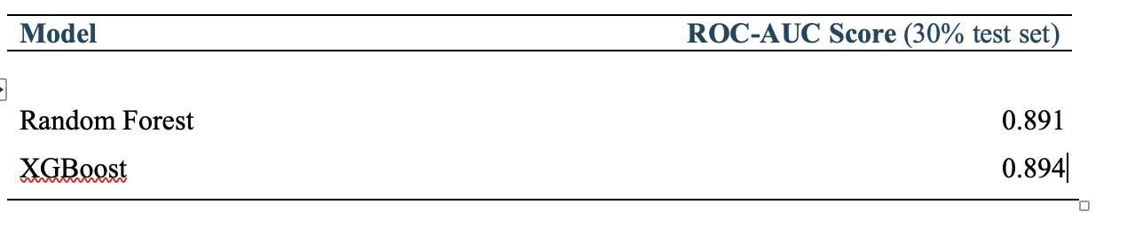
Performance Estimation
Model Choice
Tree Models
Train/Test Split
Performance Comparison
  Random forest - 0.891
  XGBoost - 0.894

Slide 11
Final Model
Selecting Model
Handling Overfitting
Choosing XGBoost over Random Forrest
Sequential learning
Limiting Depth
Reducing Noice

Slide 12
Parameters
Parameters | Values Tested | Description
n_estimators | [400, 800] | Number of trees to build sequentially
max_depth | [4, 6, 8] | Maximum depth of each tree
learning_rate | [0.05, 0.1] | Step size for updating weights
subsample | [0.8, 1.0] | Fraction of data used for each tree
colsample_bytree | [0.8, 1.0] | Fraction of features used per tree
min_child_weight | [1, 3] | Minimum sum of instance weight needed in a child
Scale_pos_weight | [0.32] | Account for imbalance data
Notes:
We performed a cross-validated grid search using Stratified 5-Fold Cross-Validation to maintain class balance in each fold within the training data only, ensuring that the test set remained a true holdout. This method allowed us to find the optimal combination of hyperparameters without overfitting.

Slide 13
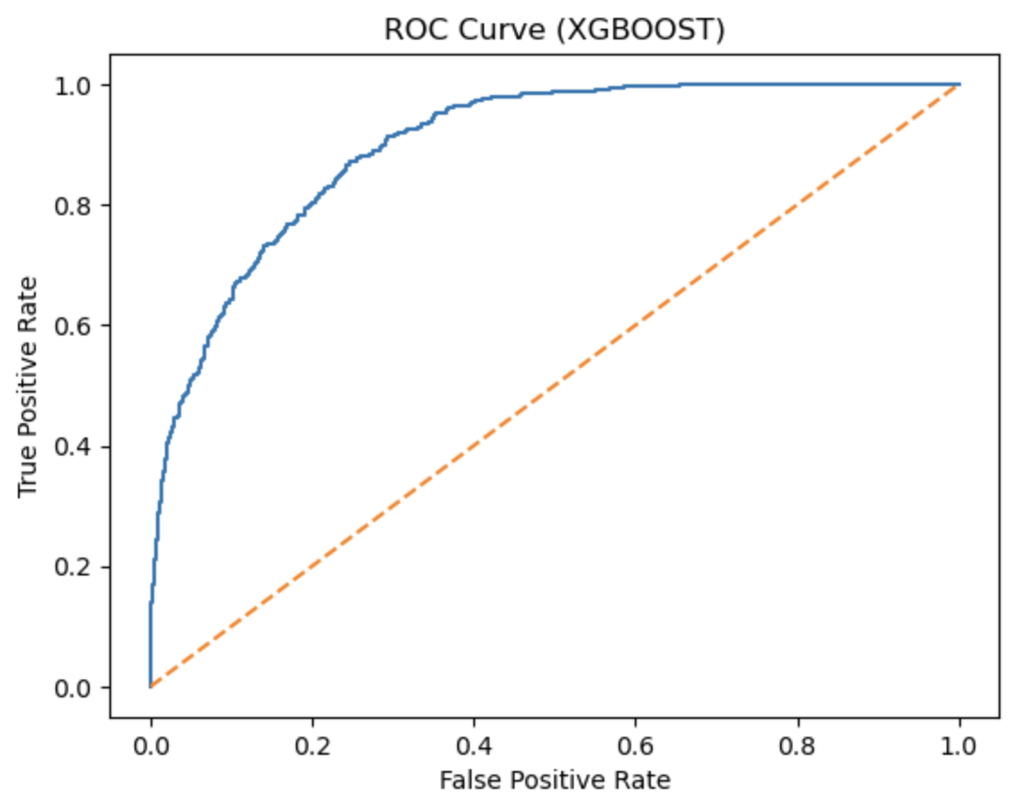
Model Evaluation
Test ROC-AUC: 0.8941
89% probability that the model will
rank a randomly chosen positive
instance higher than a randomly
chosen negative one. .
Excellent at handling missing values and complex interactions
Notes:
ROC AUC measures how well a binary classification model separates two classes (e.g., "Yes" vs. "No") across all possible probability thresholds.
The ROC-AUC was chosen as the primary evaluation metric due to its ability to measure classification accuracy. By analyzing the area under the curve, we can evaluate the model's performance across the full range of probability thresholds for both churn and non-churn classes.
By analyzing the area under the curve, we can evaluate the model's performance across the full range of probability thresholds for both churn and non-churn classes.

Slide 14
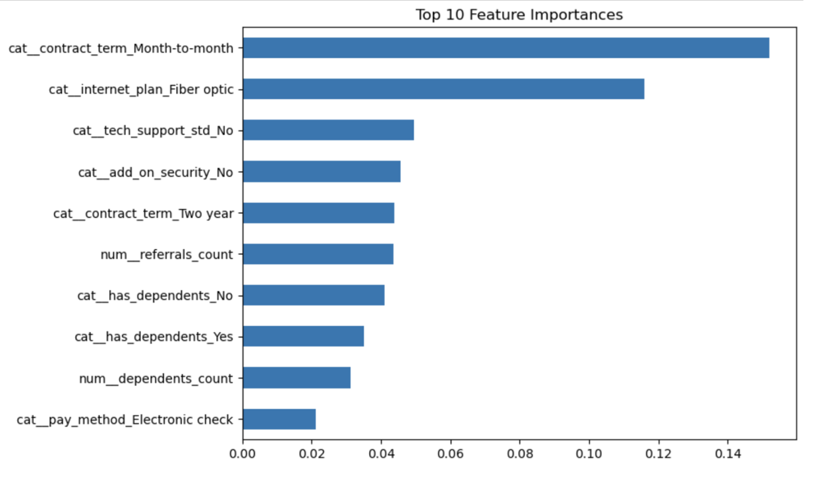
Gain Importance
The gain metric quantifies how much each feature improves the model.
Notes:
To deepen our understanding of the model, we compared the top features identified by XGBoost Gain Importance with those highlighted by SHAP values.
Higher gain means a feature is more critical for reducing prediction errors across all trees.
While Gain Importance measures how much each feature improves the model during tree construction, SHAP values quantify each feature’s contribution to individual predictions. Together, these methods provide a more complete view of which variables consistently influence the model and how they shape prediction outcomes.
XGBOOST feature

Slide 15
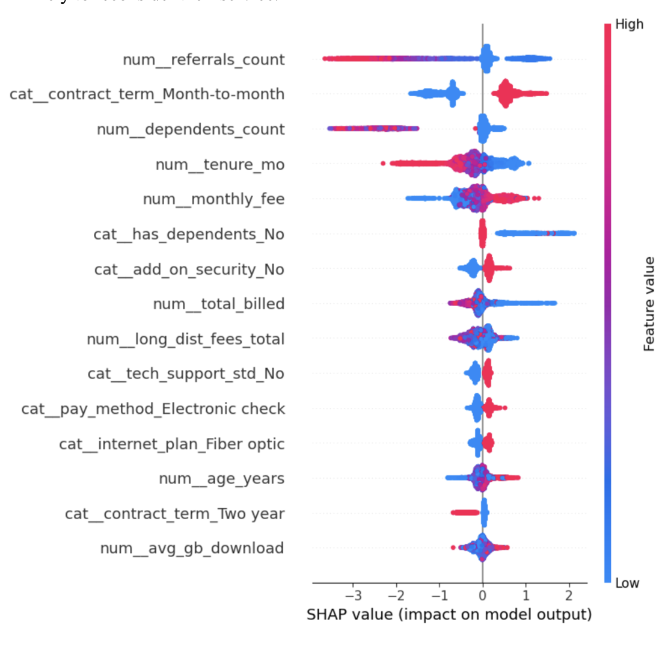
SHAP values
SHAP is also a well‑known method in post‑model evaluation to compare and interpret the final features, since it generates numeric values that quantify each feature’s contribution to the model’s predictions
Notes:
SHAP values quantify each feature’s contribution to individual predictions. Together, these methods provide a more complete view of which variables consistently influence the model and how they shape prediction outcomes.

Slide 16
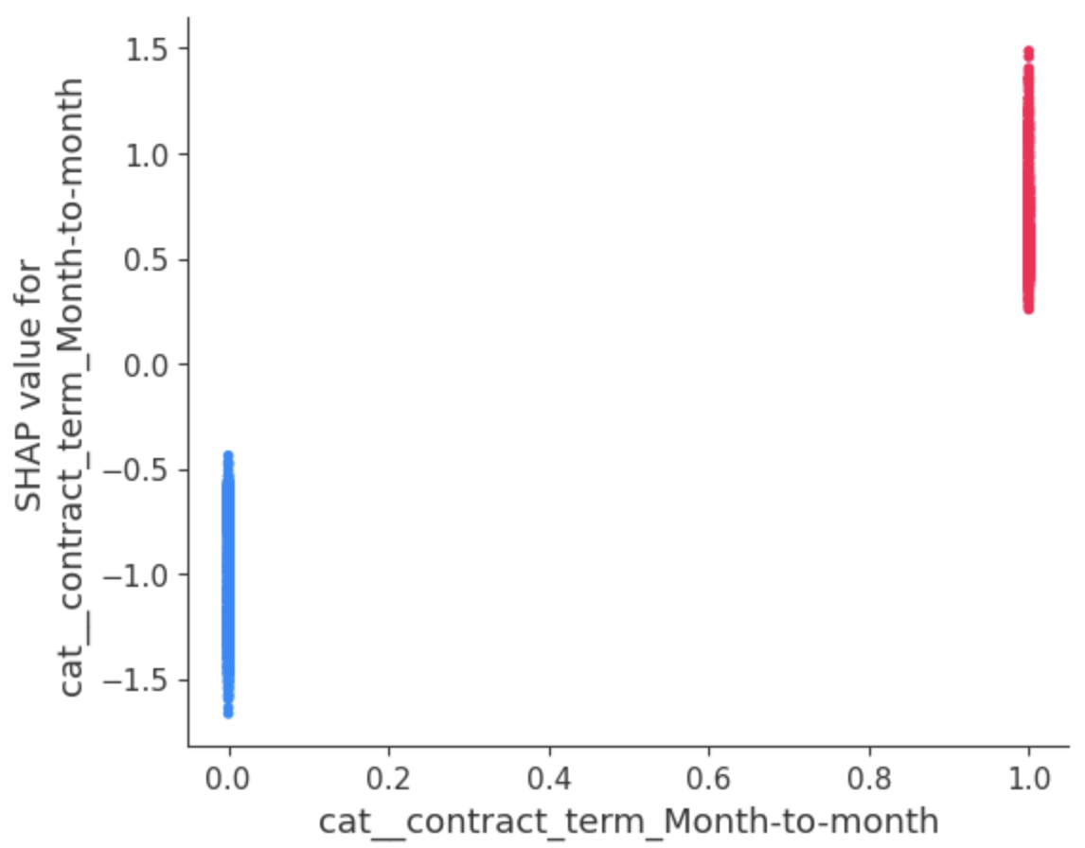
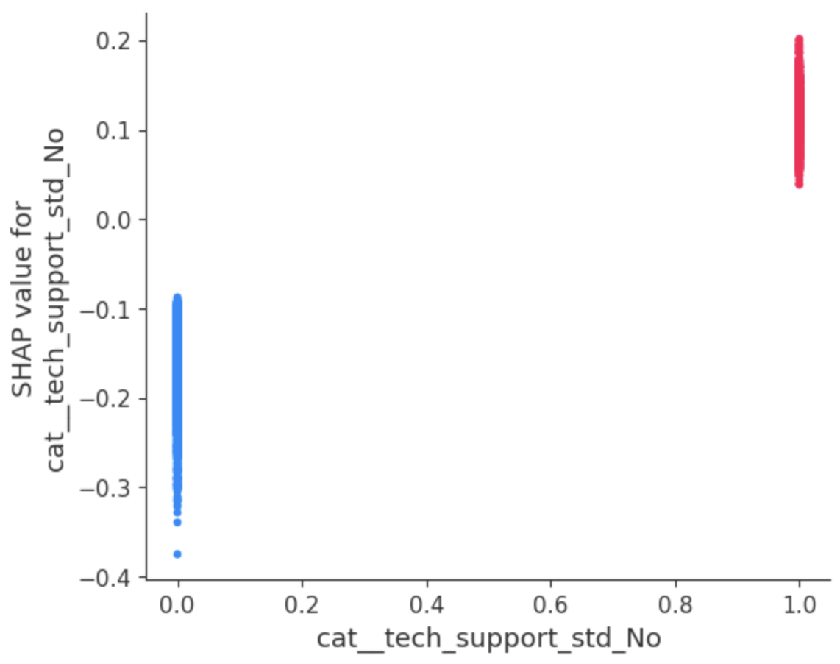
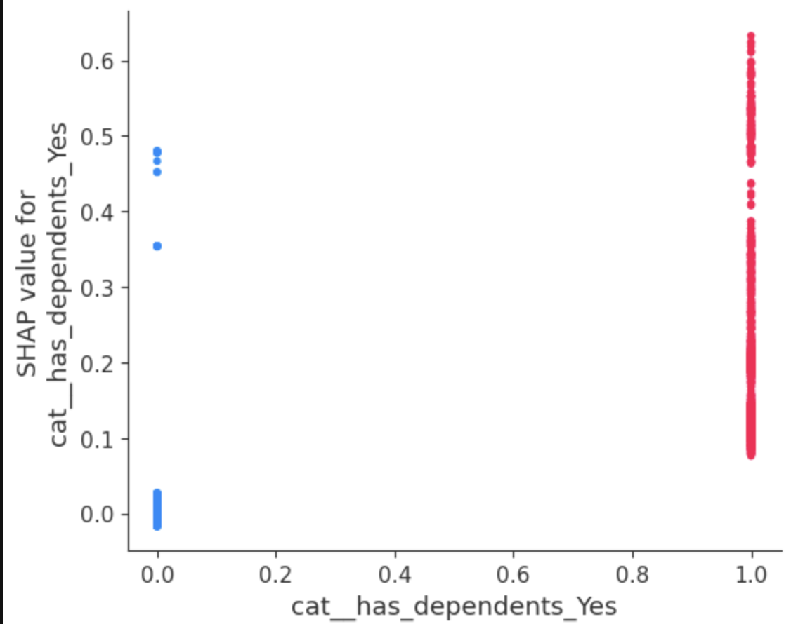
SHAP Dependency Plots
Contract term (M2M)
Tech Support
Has Dependents
Venus has a beautiful name and is the second planet from the Sun. It’s terribly hot and its atmosphere is poisonous. It’s the second-brightest natural object in the night sky
Notes:
Across both methods, several features emerge as consistently influential, indicating strong and stable predictive power. Below is a summary of the top SHAP features and how they align with the gain‑based feature importance.
Contract‑Related Features Are Dominant in Both Methods
Features tied to contract term—especially Month‑to‑Month—rank among the top predictors in both gain and SHAP analyses. This confirms that commitment level is one of the strongest drivers of customer behavior in the model.
Service Engagement Features Appear in Both Rankings
Variables such as internet plan type, tech support, and add‑on security show high gain importance and also appear prominently in the SHAP plot. These features reflect how deeply customers are engaged with the service ecosystem, which strongly influences predicted outcomes.
Demographic and Household Factors Matter Across Both Methods
Features related to dependents (both binary and numeric) appear in the top 10 gain importance list and also rank highly in SHAP values. This suggests that household structure plays a consistent role in shaping customer behavior.

Slide 17
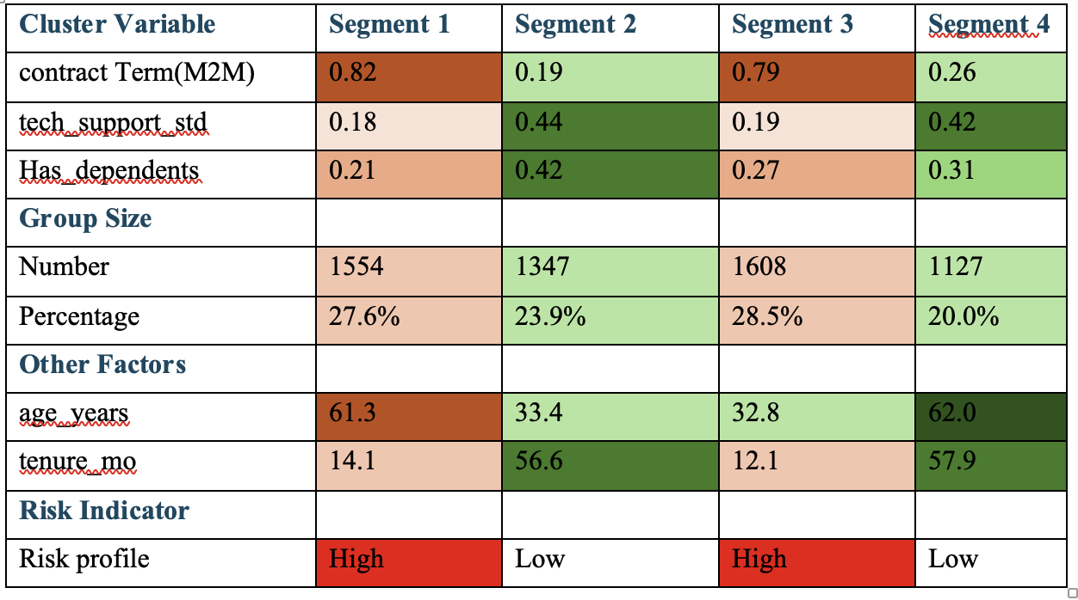
Segmentation (1/2)
Earnings calls
Venus has a beautiful name
Mars is made of basalt
Director’s report
Corporate report
Pluto is considered a dwarf planet
Financial reporting
Saturn has rings
Management discussion
Prospectus
Earth is the planet where we live
Jupiter is a gas giant
Capital structure
Auditors Report
Neptune is an ice giant
Mercury is very small
Notes:
Using these three key features—each representing a different behavioral dimension—we applied the K‑means clustering method to segment all customers in the dataset. After evaluating clustering performance and selecting a solution with relatively low inertia, we identified four distinct customer segments that reflect meaningful differences in commitment level, service engagement, and household characteristics.
K‑means clustering is a way for a computer to group similar people together based on their characteristics — even when we don’t tell it what the groups should be.
Segment 1: Older Month‑to‑Month Customers With Low Engagement
This segment represents older customers who overwhelmingly remain on month‑to‑month contracts and show very low engagement with support services. They account for 27.6% of all customers. Their average tenure is only 14 months, and only 18% use tech support, indicating weak attachment to the service. Additionally, only 21% have dependents, suggesting fewer household‑driven service needs.
Segment 2: Younger, Long‑Tenure, Highly Engaged Customers
This segment represents younger customers who have been with the company for a long time and show strong engagement with support services. They make up 23.9% of all customers. Their average tenure is 56.6 months, and 43.5% use tech support — the highest among all segments. Additionally, 42% have dependents, indicating that household needs may drive service usage.
Segment 3: Young, New, Month‑to‑Month Customers With Low Engagement
This segment represents young customers who are new to the service, have very short tenure, and are predominantly on month‑to‑month contracts. They account for 28.5% of all customers — the largest segment. Their average tenure is only 12 months, and tech support usage is low at 19%. Only 27% have dependents, suggesting fewer household‑driven service needs.
Segment 4: Older, Long‑Tenure, High‑Engagement Customers
This segment represents older customers with long tenure, high engagement, and relatively low reliance on month‑to‑month contracts. They account for 20.0% of all customers. Their average tenure is 57.9 months, and 42% use tech support. Dependents are present in 31% of households, indicating moderate family‑driven service needs.

Slide 18
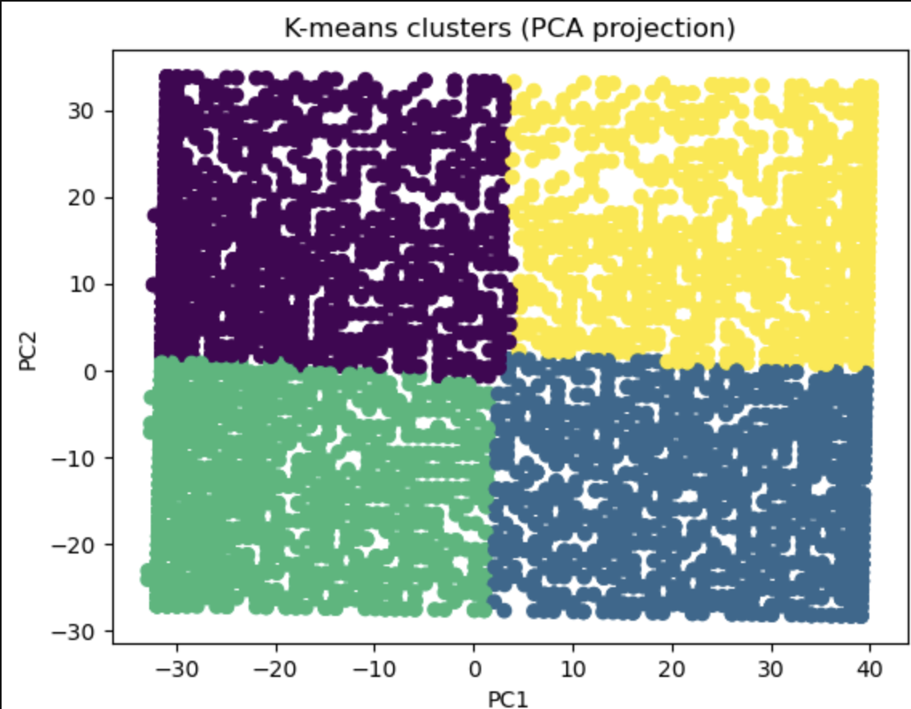
Thanks
Do you have any questions?
youremail@freepik.com
+91 620 421 838
yourwebsite.com
Please keep this slide for attrution
Notes:
Using these three key features—each representing a different behavioral dimension—we applied the K‑means clustering method to segment all customers in the dataset. After evaluating clustering performance and selecting a solution with relatively low inertia, we identified four distinct customer segments that reflect meaningful differences in commitment level, service engagement, and household characteristics.
These segments form the foundation for targeted retention strategies and allow us to tailor interventions to the specific drivers of churn within each group.

Slide 19
Segmentation(2/2)
Segment 1
Segment 2
Older Month‑to‑Month Customers With Low Engagement
Younger, Long‑Tenure, Highly Engaged Customers
Segment 3
Segment 4
Young, New, Month‑to‑Month Customers With Low Engagement
Older, Long‑Tenure, High‑Engagement Customers

Slide 20
Recommendations
Segment 3
Segment 1
Tiered Loyalty Benefits
Referral Incentives
Annual Appreciation Credit
Welcome Call Program
Guided Support Tutorials
Engagement Incentive
Segment 2
Segment 4
Introductory Contract Discounts
Bundle Upgrade Offers
Behavior Triggered Outreach
Advance Communication
Priority Support Access
Stability Guarantee
Notes:
Segment 1
Increease early engagement for older MonthtoMonth Customers
Segment 2: Reducing EarlyLife Churn for Young,New, MonthtoMonth Customers
Segment3
Strengthening Loyalty for Younger, LongTenure, Highly Engaged Customers
Segment4
Preserving Satisfaction for Older, LongTenure, HighEngagement Customers

Slide 21
Thanks
Do you have any questions?
youremail@freepik.com
+91 620 421 838
yourwebsite.com
Please keep this slide for attribution

